Slide 1
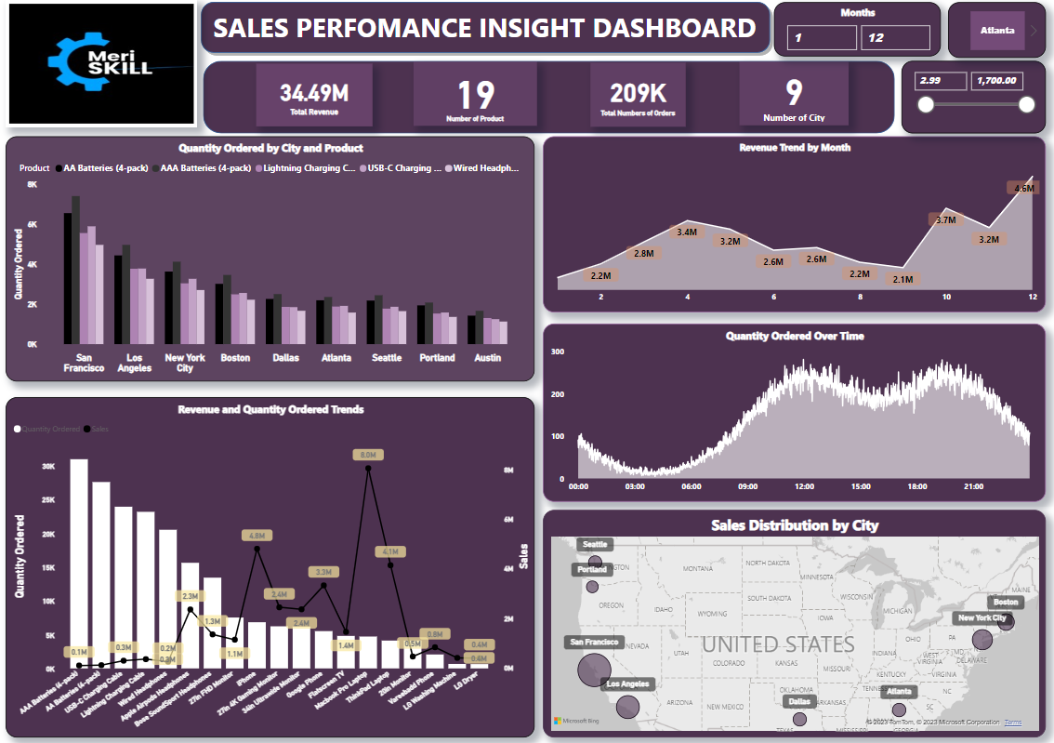

Slide 2
CITY
San Francisco emerges as the standout leader in terms of sales, followed closely by Los Angeles, New York, and Boston, all of which display promising sales figures. Interestingly, these locations also share the commonality of high demand for our products. This dual trend of strong sales performance and high product demand in these key cities indicates a substantial growth opportunity
INSIGHTS
Focusing our efforts on these areas, whether through marketing initiatives, inventory management, or customer engagement strategies, could further bolster our sales and market presence, potentially leading to even greater success in these key markets.
recommendation

Slide 3
PRODUCT
Despite AA batteries (4-pack) and AAA batteries being the two most highly demanded products across all branches, they collectively contributed only 0.58% of the total revenue. In contrast, the MacBook Pro laptop and iPhone, while not as highly demanded, emerged as the top sales performers, accounting for a significant 37.2% of the total revenue. This observation highlights a fascinating trend in our sales data: the products with the highest demand often yield a disproportionately lower share of revenue compared to products with lower demand.
INSIGHTS
This suggests the need for a deeper analysis of pricing strategies, cross-selling opportunities, or potential upselling tactics to optimize revenue generation from our highly demanded products.
recommendation

Slide 4
TREND
INSIGHTS
Our sales data for the year reveals an interesting pattern. During the first three months, we experienced an accelerating rate of sales. However, this was followed by a noticeable shortfall in sales over the next two and a half months. What's particularly intriguing is the sharp uptick in growth that occurred from that point onwards, peaking in December.
When examining the sales by time of day, we found that the hours between 10:00 AM and 2:00 PM, as well as 6:00 PM and 10:00 PM, consistently attracted the highest number of orders throughout the year. Conversely, demand for our products was notably low during the late hours, from 12:00 AM to 9:00 AM, accounting for a mere 0.36% of our total sales.
Optimize sales by targeting peak hours, managing inventory smartly, and engaging late-night shoppers. Expand in strong markets and investigate sales shortfalls for improvements.
recommendation

